Slide 1
Segmenting Satellite Images
Maria Nicolae
Mitcan Radu Constantin
Junzhe Yin
Alexander Stromberger

Slide 2
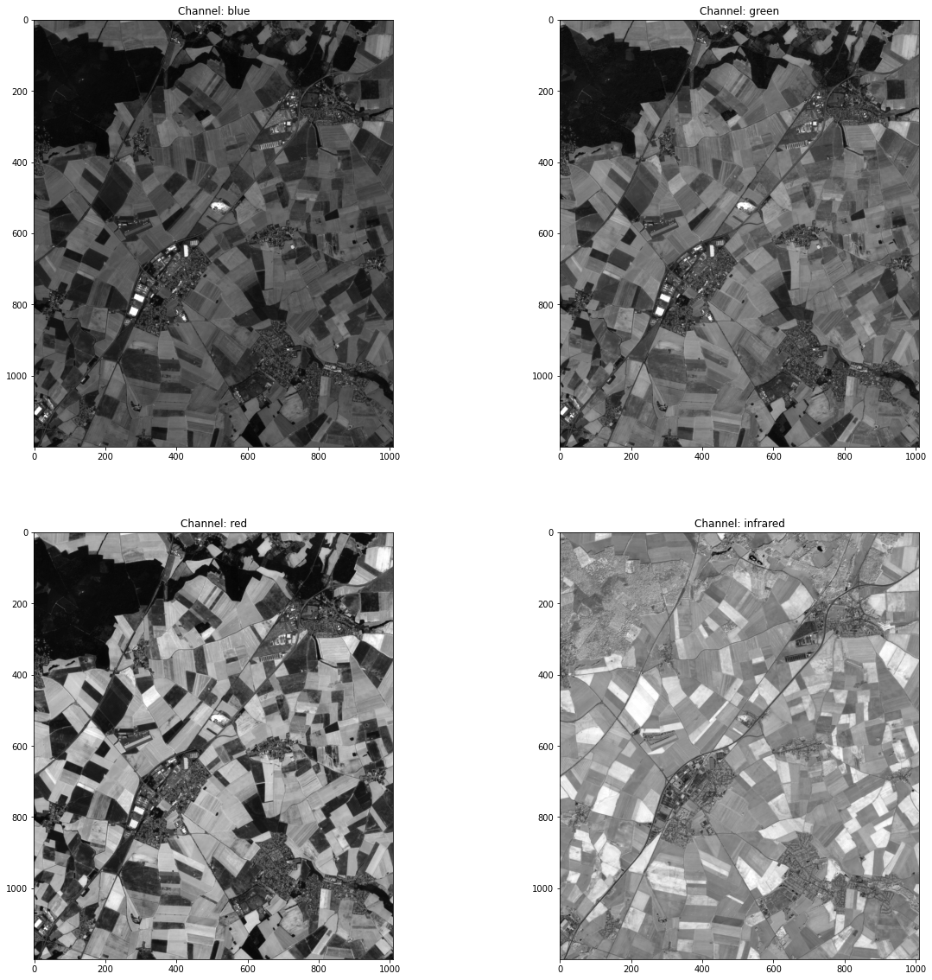
Preliminaries
The focus of our work was processing satellite imagery captured by Sentinel-2.
Important for monitoring the environment and urban development
The dataset consisted of two images decomposed in their four corresponding channels:
Red
Green
Blue
Near Infrared (encodes information about the vegetation)
A pixel corresponds to 100m²

Slide 3
What we have done
Workflow approach:
Load the images
Analyse each color channel and get the distributions of the gray levels.
Compute de NDVI image.
Segment the objects for each identified class:
Cities
Roads
Fields
Forest
Verifying the accuracy by overlaying the masks and the coloured image.

Slide 4
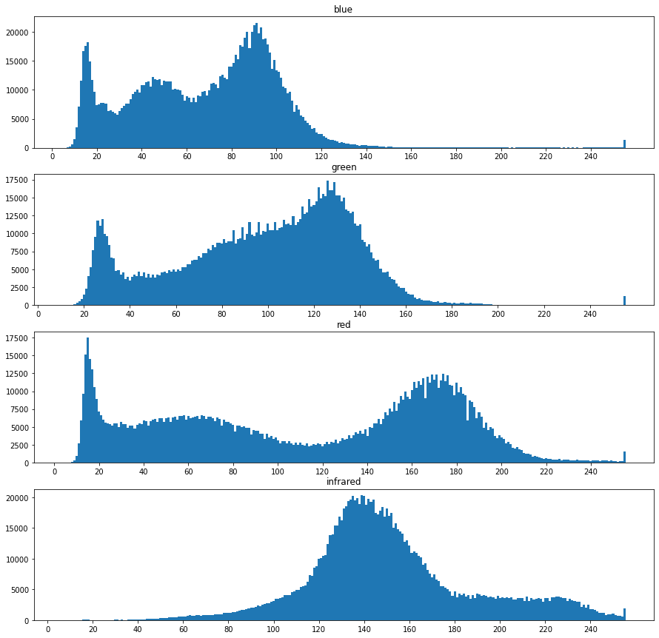
Steps 1 + 2
Visually analysing the distributions of each color channel.
Identify the peaks and select thresholds to use.
We can do a primary object segmentation by thresholding the channels -> than apply morphological operations.

Slide 5
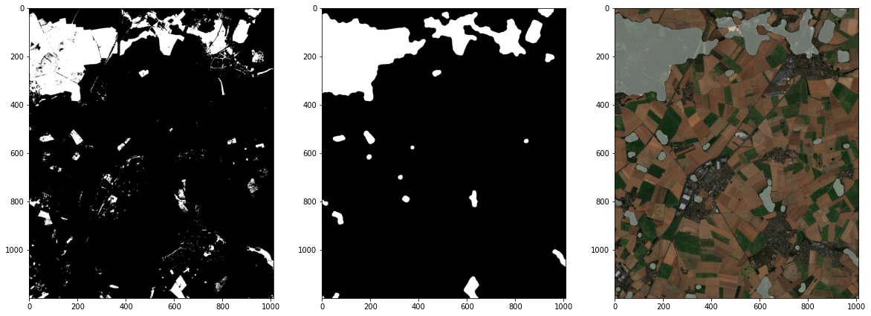
Steps 1 + 2
Example: Blue channel - if values < 25, then the dense forest zones will be prominent (1), opening + closing + opening to get rid of the bright small regions (2) , overlay to see the accuracy (3)

Slide 6
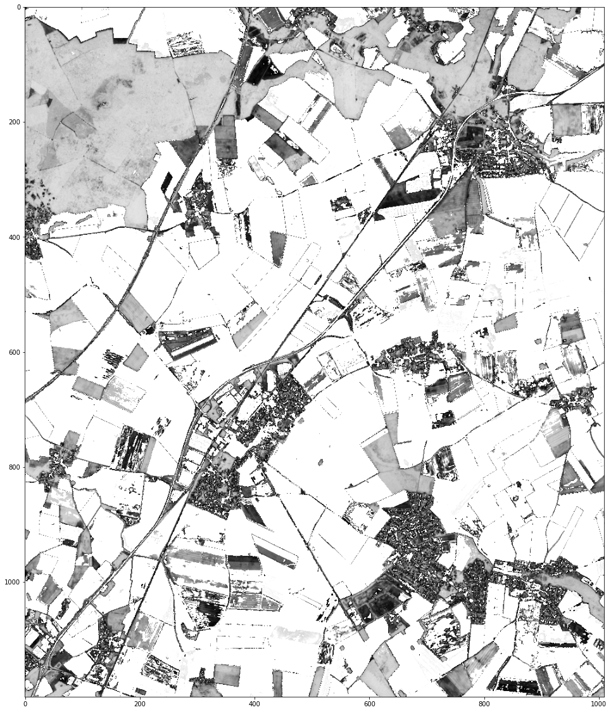
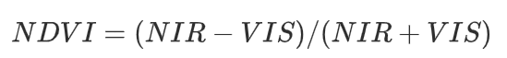
NDVI
Objective: Whether the image being observed contains the vegetation
NIR: near-infrared image(which the vegetation strongly reflects)
VIS: red Channel(which the vegetation absorbs/has a low reflectance)
Formulation:

Slide 7
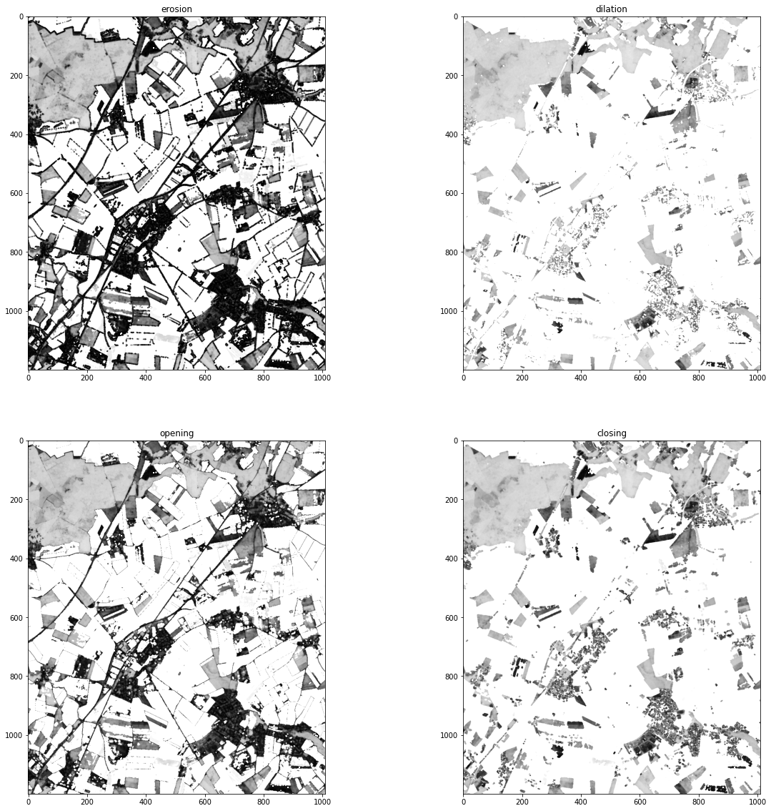
Morphological function
Performing the all 4 morphological functions of the NDVI
Choosing the most relevant one, in order to obtain a map of cities and roads

Slide 8
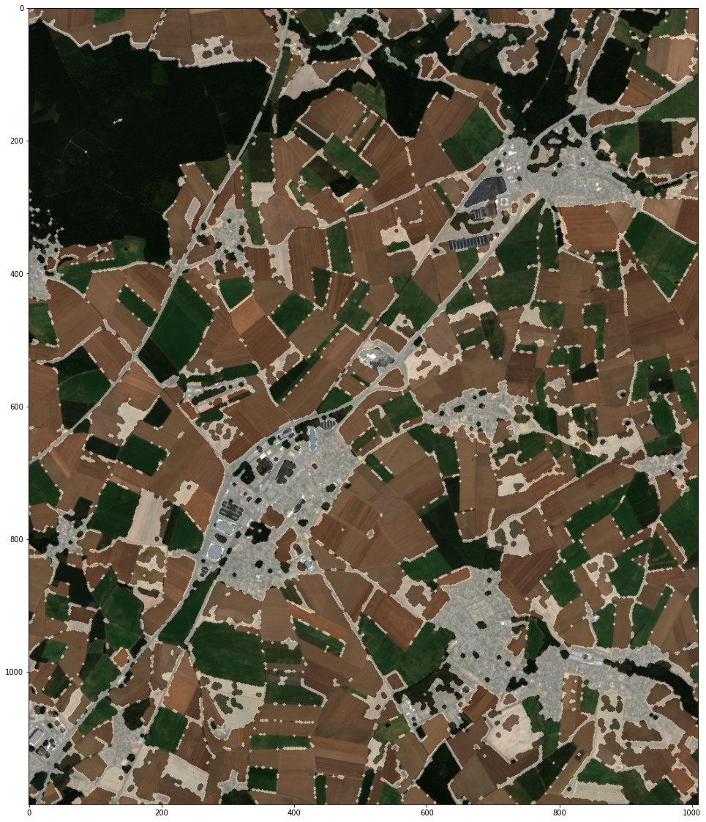
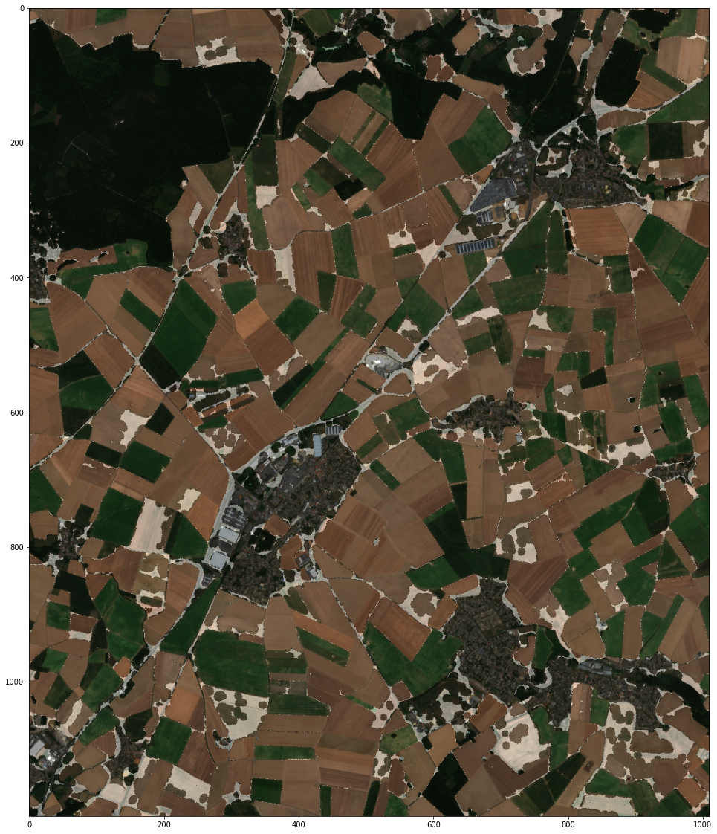
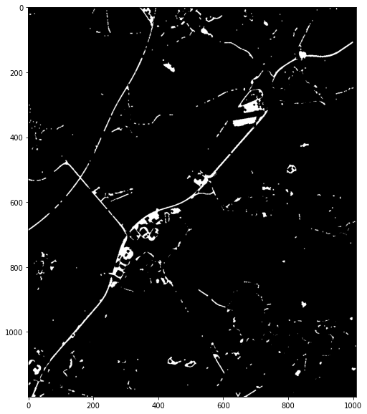
Segmenting the roads
Cities and roads
Only the roads
Roads final form

Slide 9
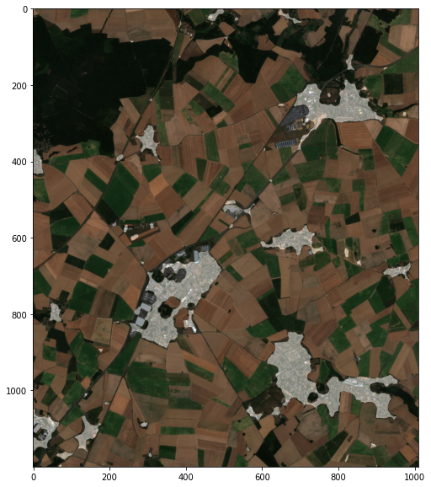
Segmenting the cities
Combine two different inputs
Cities have less vegetation → NDVI can help us to find these parts
Cities have many buildings & streets → Top-hat helps us to find those structures
Preprocessing
NDVI: apply opening operation to filter out small structures and apply threshold
Top-hat: apply closing operation and threshold
Combine them with a binary and

Slide 10
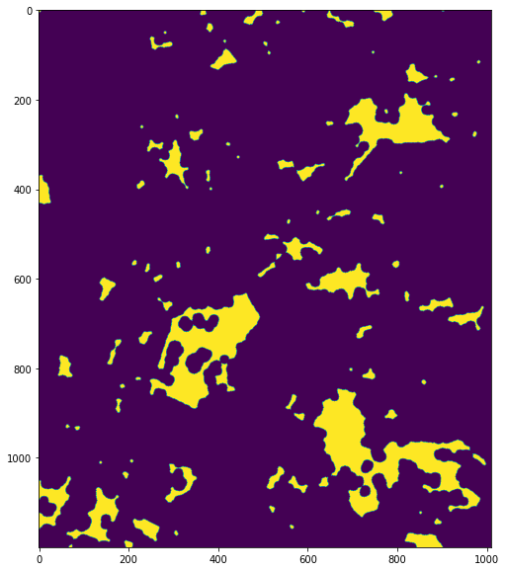
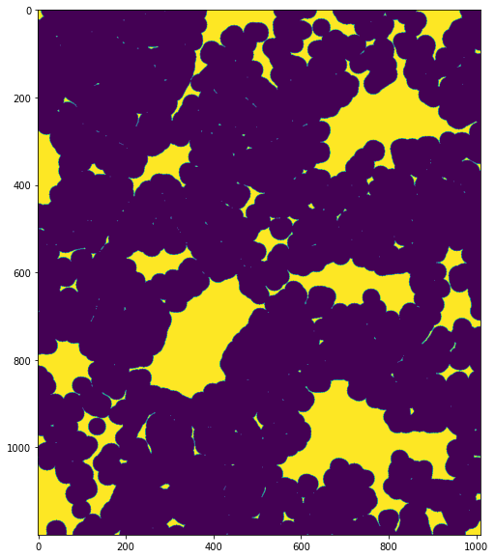
Segmenting the cities
NDVI
Top-hat
Result

Slide 11
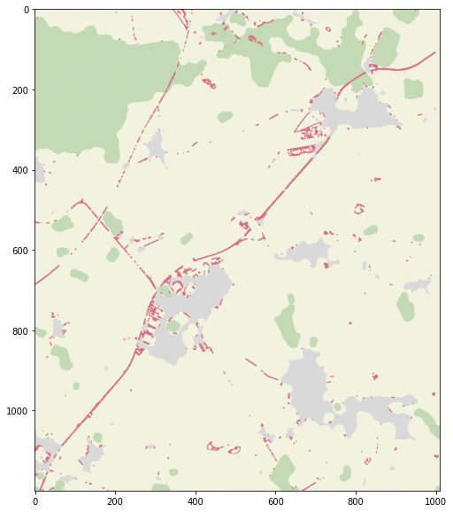
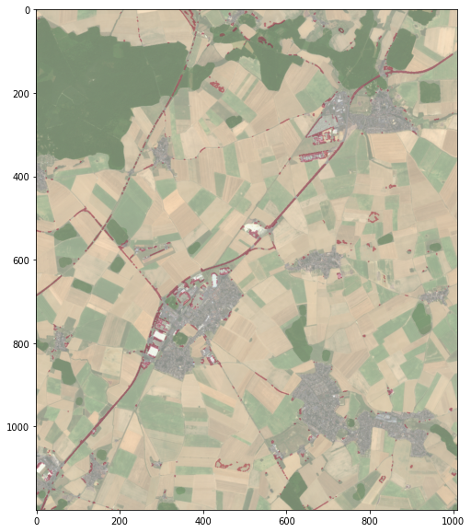
Results

